Slide 1
Computer Architecture (Fall 2021)
Lecture 5
Quantitative Approach
Dr. Yujuan Tan (谭玉娟)
Office: Main Building 0626
Email: tanyujuan@cqu.edu.cn

Slide 2
Principle of Locality
• Temporal Locality
– a resource that is referenced at one point in time will
be referenced again sometime in the near future
• Spatial Locality
– the likelihood of referencing a resource is higher if a
resource near it was just referenced
• 90/10 Locality Rule of Thumb
– a program spends 90% of its execution time in only
10% of its code
• hence, it is possible to predict with reasonable accuracy
what instructions and data a program will use in the near
future based on its accesses in the recent past
• this is a consequence of how we program and we store the
data in the memory
Notes:
•时间位置
–在某个时间点引用的资源将
在不久的将来再次被引用
•空间位置
–如果出现以下情况，则引用资源的可能性更高：
它附近的资源刚刚被引用
•90/10位置经验法则
–程序90%的执行时间只花在代码的10%
•因此，可以以合理的精度进行预测
在不久的将来，程序将使用哪些指令和数据
基于最近访问的未来
•这是我们如何编程和存储数据的结果
内存中的数据

Slide 3
Principle of Locality - Example
• Cache
– directly exploits temporal locality providing faster
access to a smaller subset of the main memory which
contains copy of data recently used
– but, all data in the cache are not necessarily data that are spatially close in the main memory…
– …still, when a cache miss occurs a fixed-size block of
contiguous memory cells is retrieved from the main
memory based on the principle of spatial locality
Notes:
•缓存
–直接利用时间位置，更快地访问包含最近使用的数据副本的主内存的较小子集
–但是，缓存中的所有数据不一定都是主内存中空间相近的数据…
-尽管如此，当发生缓存未命中时，基于空间局部性原则从主内存中检索固定大小的连续内存单元块

Slide 4
“Make the Common Case Fast”
• “the most important, pervasive, and simple principle of computer design”
– in making a design trade-off…
• favor the frequent case rather than infrequent case
– when determining how to allocate resources…
• favor the frequent event rather than the rare event
– when optimizing the design of a module…
• target the average functional behavior
• …besides, the frequent case is often simpler
1. How to determine what the frequent case is?
2. How to determine the amount of the possible
performance gain in making the frequent case
faster ?
Notes:
•“最重要、最普遍、最简单的计算机设计原则”
–在进行设计权衡时…
•支持经常发生的情况，而不是不经常发生的情况
–在决定如何分配资源时…
•喜欢经常发生的事件，而不是罕见的事件
–优化模块设计时…
•以平均功能行为为目标
•…此外，常见的情况往往更简单
1.如何确定什么是常见病例？
2.如何确定在使频繁案例更快的过程中可能获得的性能增益？

Slide 5
“Make the Common Case Fast”
• “the most important, pervasive, and simple principle of computer design”
– in making a design trade-off…
• favor the frequent case rather than infrequent case
– when determining how to allocate resources…
• favor the frequent event rather than the rare event
– when optimizing the design of a module…
• target the average functional behavior
• …besides, the frequent case is often simpler
1. How to determine what the frequent case is?
2. How to determine the amount of the possible
performance gain in making the frequent case
faster ?

Slide 6
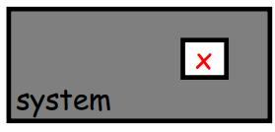
Amdahl’s Law
• What is the overall
speedup after improving a
component x of a system?
• If component x is improved by Sx and component
x affects a fraction Fx of the overall execution
time then
Fx /Sx： new exec. time of improved part

Slide 7
Amdahl’s Law
Speedup = time_{without enhancement} / time_{with enhancement}
An enhancement speeds up fraction f of a task by factor S
time_{new} = time_{orig}·( (1-f) + f/S )
S_{overall} = 1 / ( (1-f) + f/S )
time_{orig}
time_{orig}
time_{orig}
1
(1 - f)
f
(1 - f)
f
time_{new}
time_{new}
(1 - f)
f/S
(1 - f)
f/S
Notes:
现实生活中的类比：在经历了60分钟的交通堵塞后，你能在最后一英里里通过超速来弥补多少时间？
计算机体系结构中的应用
精简指令集计算机
优化以快速执行常用指令
不经常使用的指令可能需要很长时间，甚至需要软件模拟
我们应该集中精力改进经常发生的事件或经常使用的机制
Real life analogy: After driving through 60 minutes of traffic jam, how much time can you make up by speeding in the final mile?
Applications in Computer Architecture
RISC - Reduced Instruction Set Computer
Optimized to execute frequently used instructions quickly
Infrequently used instructions can take a long time, or even emulated by software
We should concentrate efforts on improving frequently occurring events or frequently used mechanisms

Slide 8
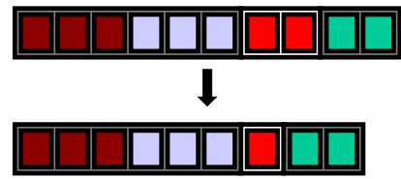
Amdahl’s Law - Example
If we optimize the module for the floating-point instructions by a factor of 2, but the system will normally run programs with only 20% of floating point instructions then the speedup is only
Notes:
If we optimize the module for the floating-point instructions by a factor of 2, but the system will normally run programs with only 20% of floating point instructions then the speedup is only

Slide 9
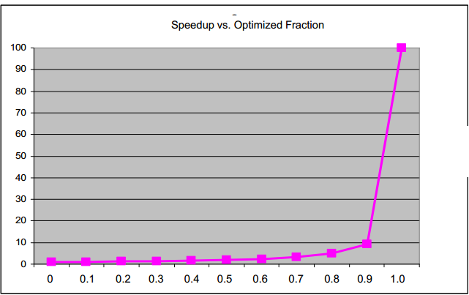
Amdahl’s Law - Example
•If Sx=100, what is the overall speedup as a function of Fx?

Slide 10
Amdahl’s Law and the Law of Diminishing Returns
• the closer to 1 is Fx, the closer to Sx is the
overall speedup…
– i.e. [make common case fast]
• however, as Sx → ∞, speedup → 1 / (1- Fx)
– i.e., once Fx/Sx is small with respect to (1-Fx)
the price/performance ratio falls rapidly as Sx is
increased
• the incremental improvement in speedup gained
by an additional improvement in the performance
of just a portion of the computation diminishes
as improvements are added

Slide 11
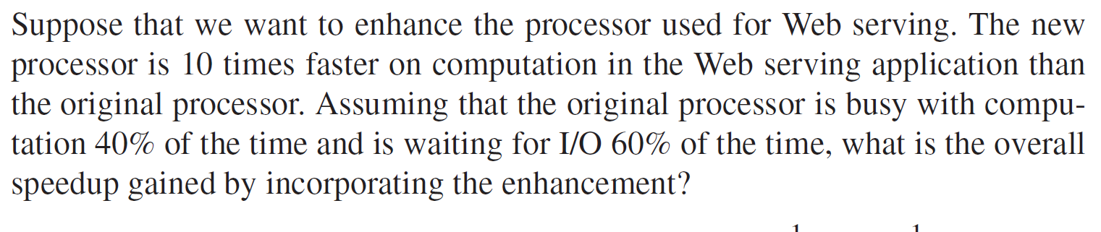
Amdahl’s Law - Example
Example: H&P 5th P47
Answer
Notes:
假设我们想要增强用于Web服务的处理器。新处理器在Web服务应用程序中的计算速度是原始处理器的10倍。假设原始处理器在40%的时间里忙于计算，在60%的时间里等待I/o，那么通过合并增强功能获得的总体加速比是多少？

